Slide 1
C2P India
QA Track
Test Data Understanding & Hands-On

Slide 2
Agenda
Test Data Understanding
Question and Answers
Walkthrough's

Slide 3
Agenda
Test Data Understanding
Question and Answers
Walkthrough's

Slide 4



Payment Message Formats
MT Format (*.txt)
ISO Format (*.xml)
Proprietary
Gateway
TSV Format (*.tsv)
TVA
The incoming file from the payment governing body towards bank can be of different types:-
MT Swift Format (*.txt)
ISO - 20022 Format (*.xml)
Proprietary Format (*.tsv)

Slide 5
SWIFT & SWIFT Formats
SWIFT stands for Society for Worldwide InterBank Financial Telecommunications.
An automated payment system used to transfer funds between different countries.
SWIFT is
A cooperative organization created and owned by banks which operates a network to facilitate the exchange of payment and other financial messages between financial institutions throughout the world.
A messaging network. Note that SWIFT does NOT move any money.
The most widely used Financial Network on the planet
Two different message standards
MT (Text Format)
MX (XML Format)

Slide 6
SWIFT MT – Header Block Information
Any SWIFT MT message is confined in 5 different Blocks.
SWIFT MT Headers
Application Header
User Header
Text /Body
Trailer
Basic Header

Slide 7
Sample SWIFT MT Message
{1:F01XCTABEBBAXXX1822765812}
{2:O1031235141209BARCGB22KTRD18850565201412091235N}
{3:{113:URGT}}
{4:
:20:UniqueRefa
:23B:CRED
:32A:141219EUR50,00
:33B:EUR50,00
:50F:/1234567
1/Mr Edward
2/RUE JOSEPH II, 19
3/CH/1044/Geneva
:57:XCTABEBB
:59:/321567
Mrs Elaine
555, S. FLOWER STREET
BE/Brussels/3006
:71A:SHA
-}
{5:{PDE:100510WDCMESESDXXX0987654321}{PDM:100510XCTABEBBAXXX1234567890}}
Basic Header Block
Application Header Block
User Header Block
Text Block or body
Trailer Block

Slide 8
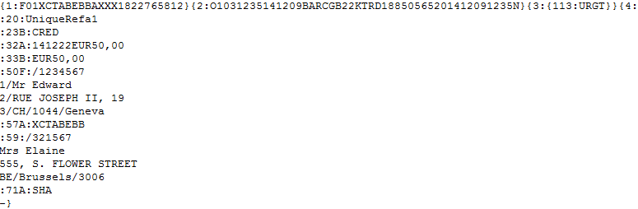
SWIFT MT Format
A Minimal MT Swift Format (MT103.txt)
Receiving Party
Sending Party
Unique Reference Id
Message Priority
Settlement Date, Settlement Currency & Amount
Debit Party Information
Credit Party Agent
Credit Party Information
Above is sample payment MT103.txt file (a Swift MT payment) that would enter into the bank application.

Slide 9
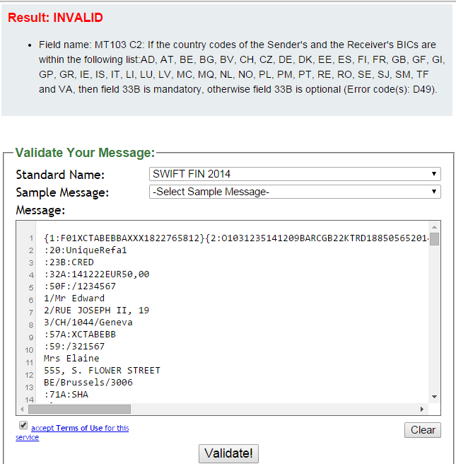
Validate your Swift messages
A utility that you can use to validate your SWIFT Message file.
Navigate to the Web Page http://mds.c24io.net/validate/swift
Select appropriate SWIFT Standard to validate.
Enter a SWIFT message into the text box
Accept the Terms of Usage.
Click on the Validate.
To demonstrate the functionality, sample valid and invalid messages are provided.
In the example here, 33B is required but was not in the file, thus the Validation error is thrown by the utility.
This utility is available with a Disclaimer. But is best available as of now.

Slide 10
Agenda
Test Data Understanding
Question and Answers
Walkthrough’s

Slide 11
Walkthrough's
Walkthrough of the real MT103 Sample File
Walkthrough of the SWIFT reference guide. e.g. MT103.
Walkthrough of the different options that can be used for a particular tag. E.g. tag 57 in MT103 payment message can be populated with either of options A, B, C, or D.

Slide 12
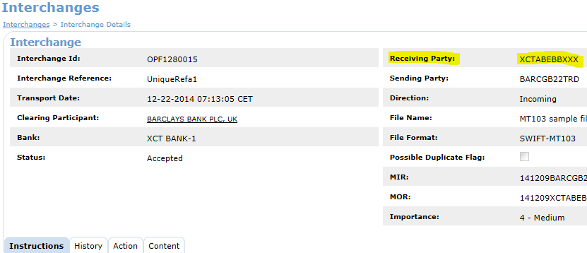
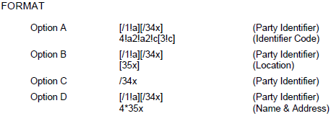
Walkthrough's
Sample Interchange
Different options for tag 57 for MT103

Slide 13
What you should know after this?
What is SWIFT Message?
Different information blocks of a SWIFT message.
Data Definition for Various components of a SWIFT message.
Validating your SWIFT message.
Understanding Swift reference guide.

Slide 14

Question *A matter requiring resolution or discussion.
Open Your Mind
Widen Your Thoughts

Slide 15
EMEA – Headquarters
Brussels, Belgium
info@clear2pay.com
APAC
Sydney, Australia
info.apac@clear2pay.com
Americas
Atlanta, USA
info.americas@clear2pay.com
www.clear2pay.com

